Slide 1
.
.....uujkiliikk..........................................
My Project
HTML/CSS/JAVAscript
Nitish . . . .

Slide 2
Home page of WebSite

Slide 3
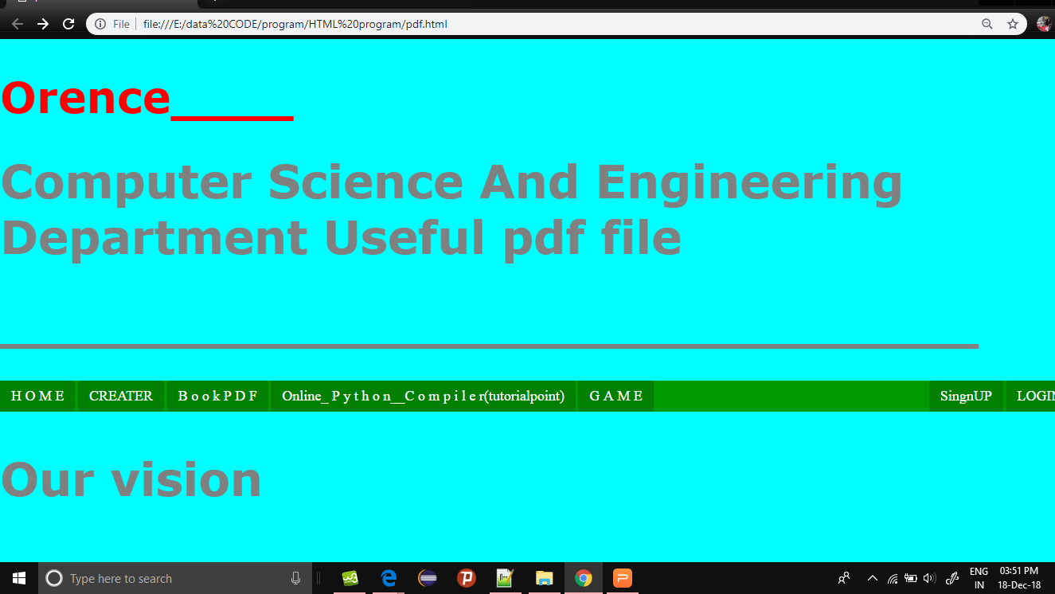

Slide 4
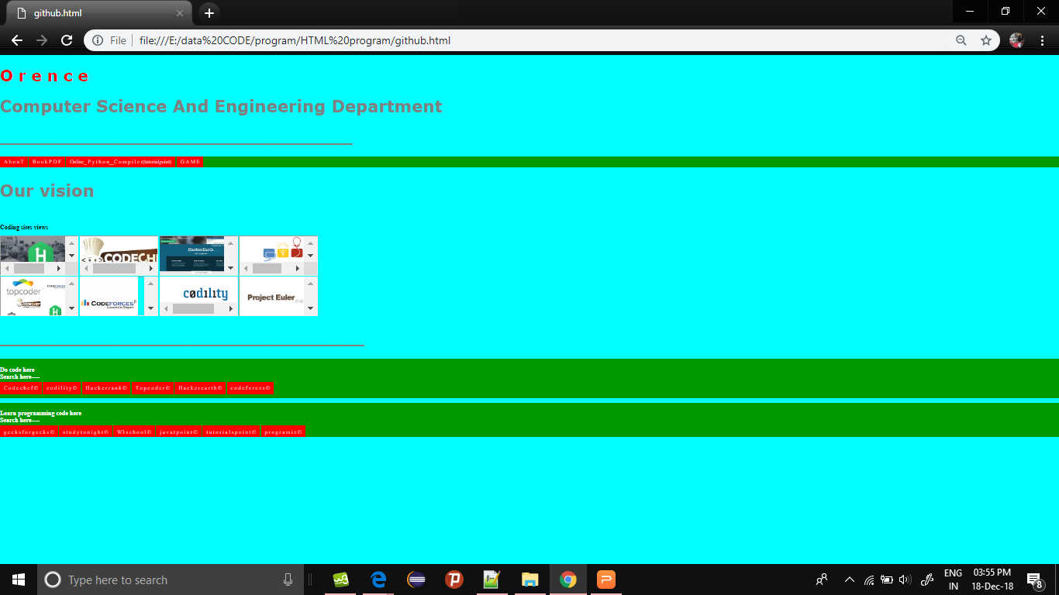
After Home page

Slide 5
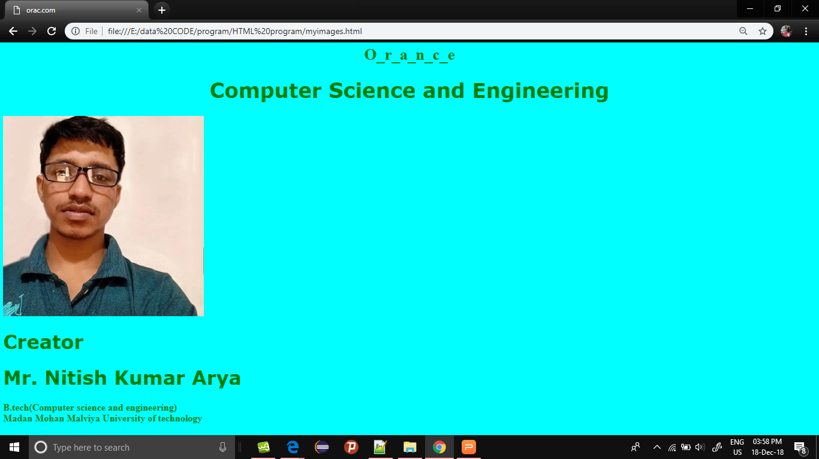
About/Creater

Slide 6
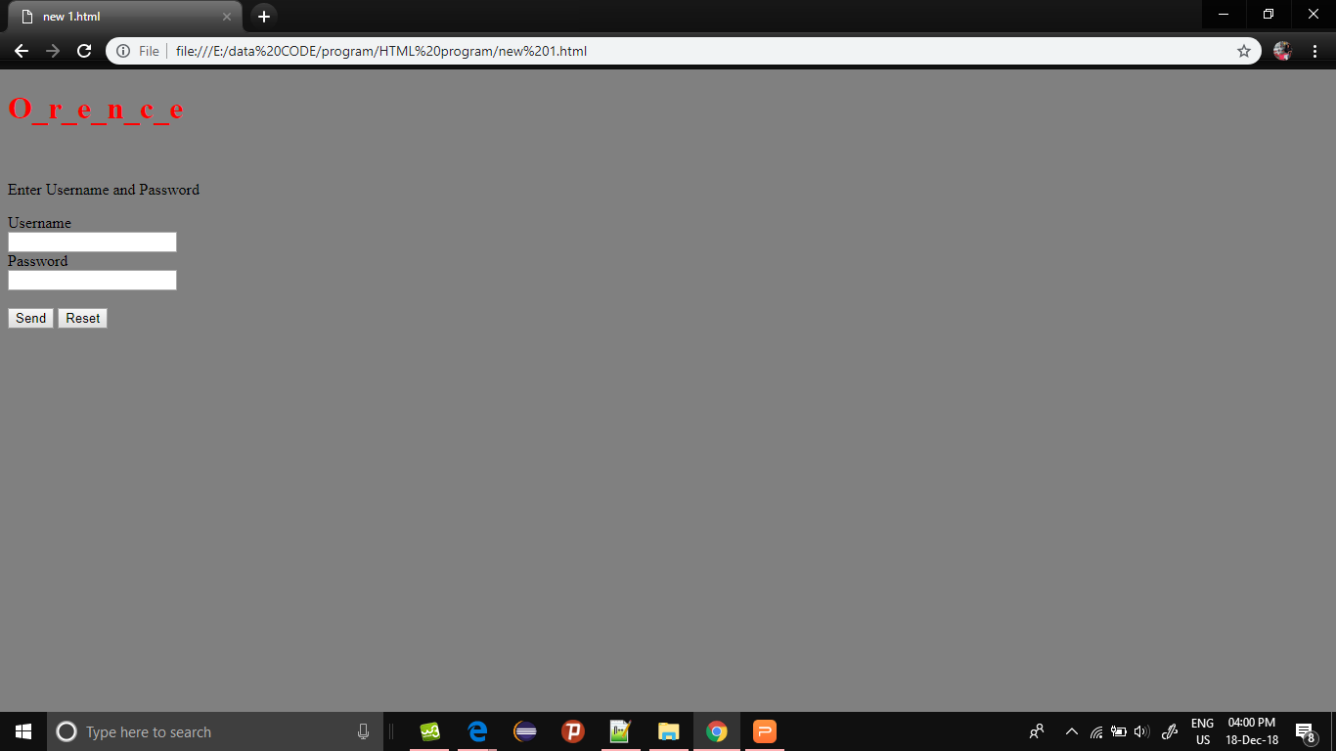
Login Page

Slide 7
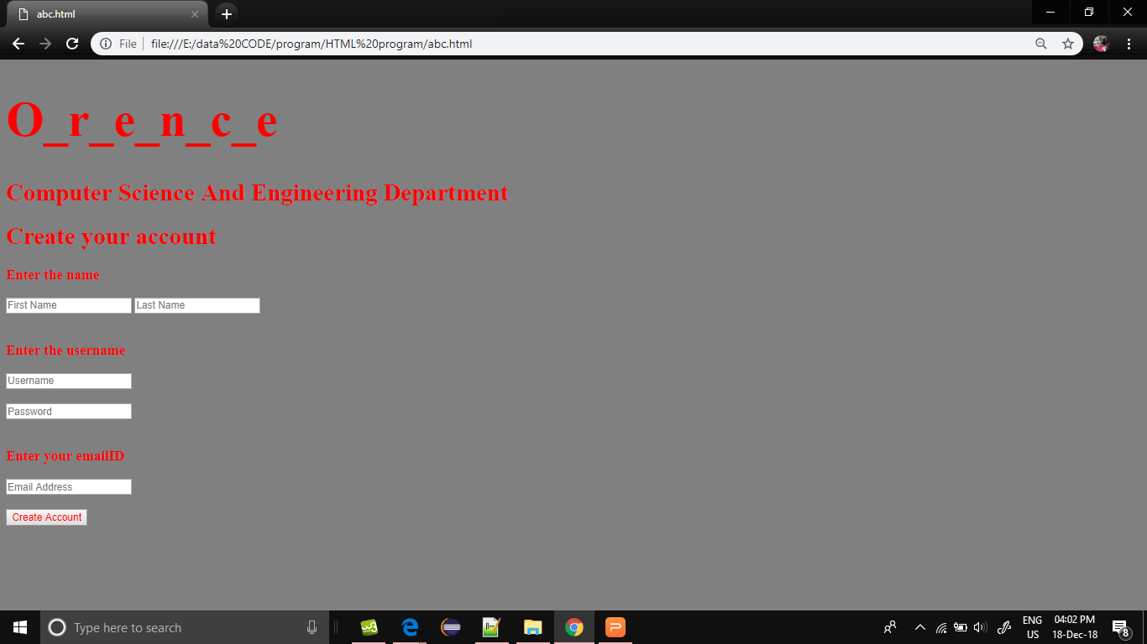
SignUp

Slide 8
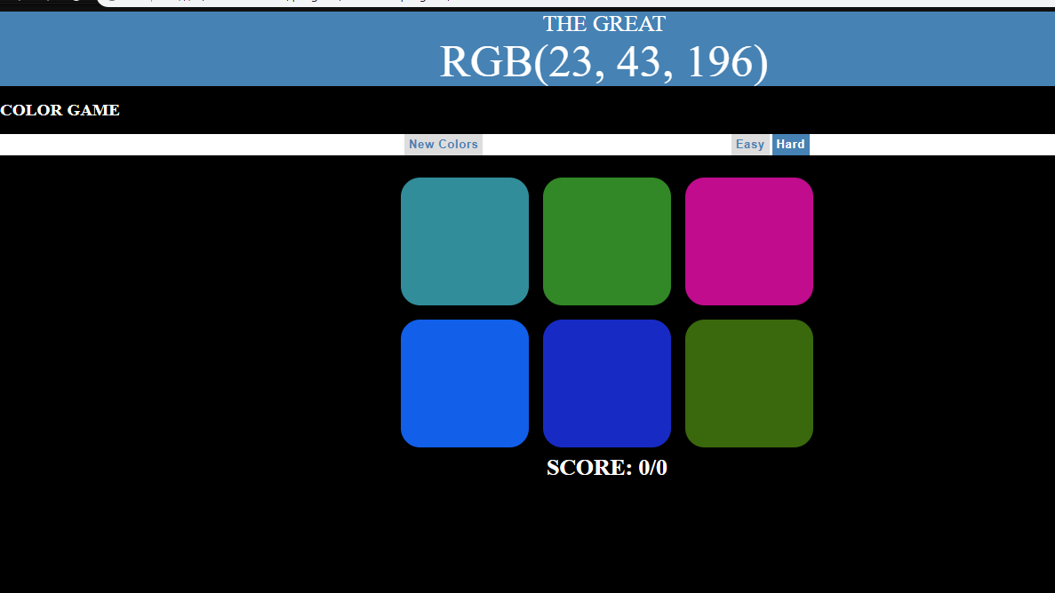
Color smallGame

Slide 9
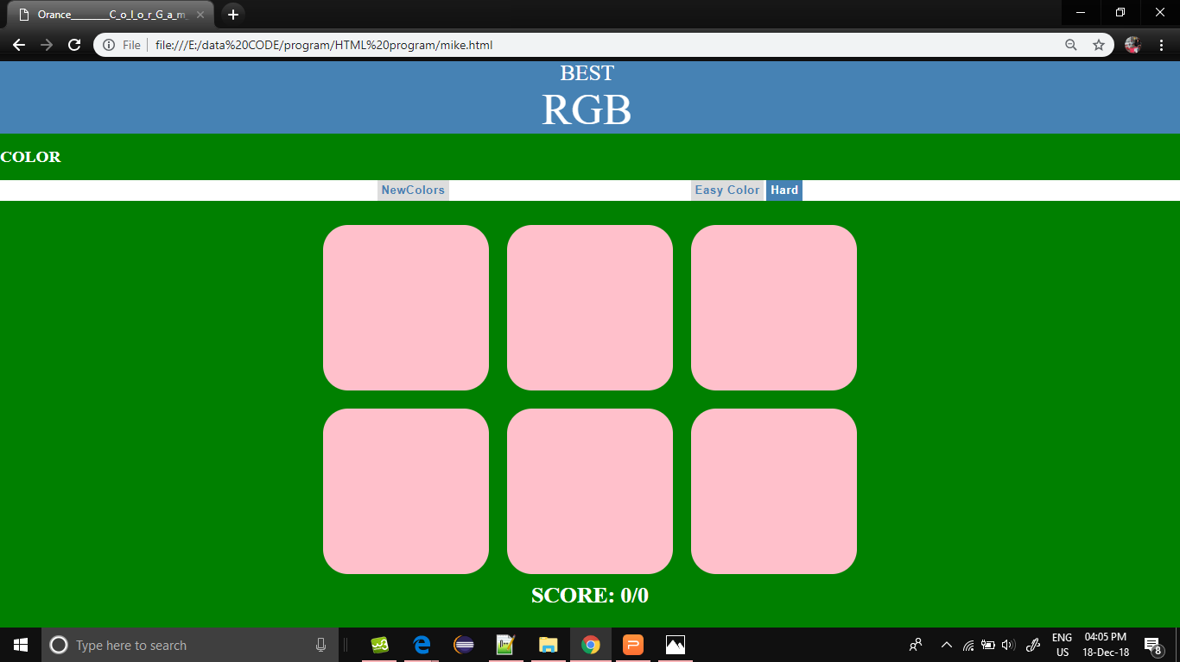

Slide 10
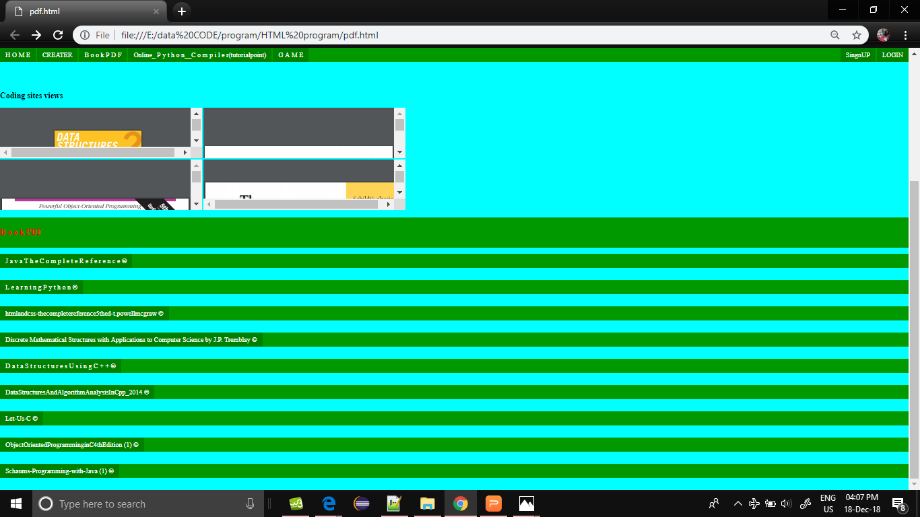
BooK Pdf

Slide 11
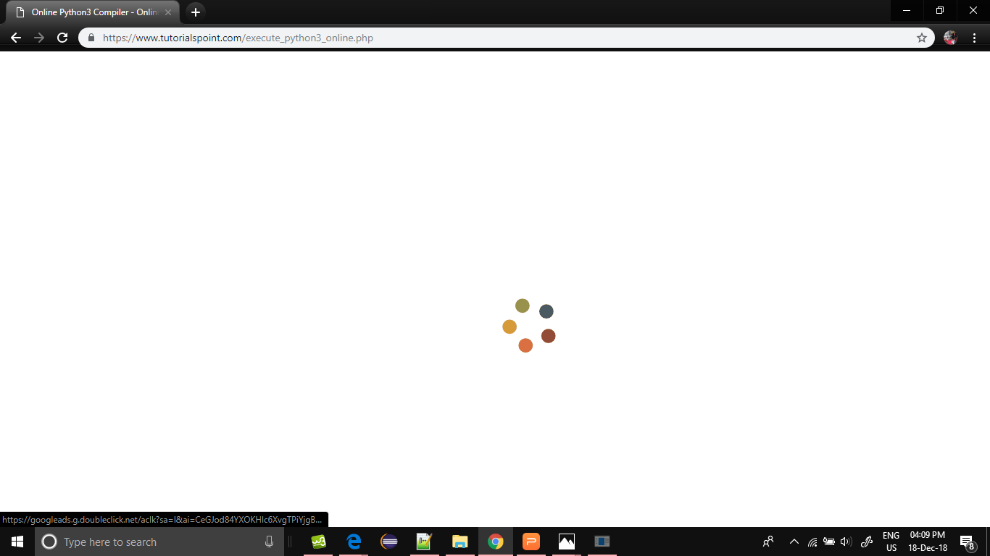
Embadding Online Compiler

Slide 12
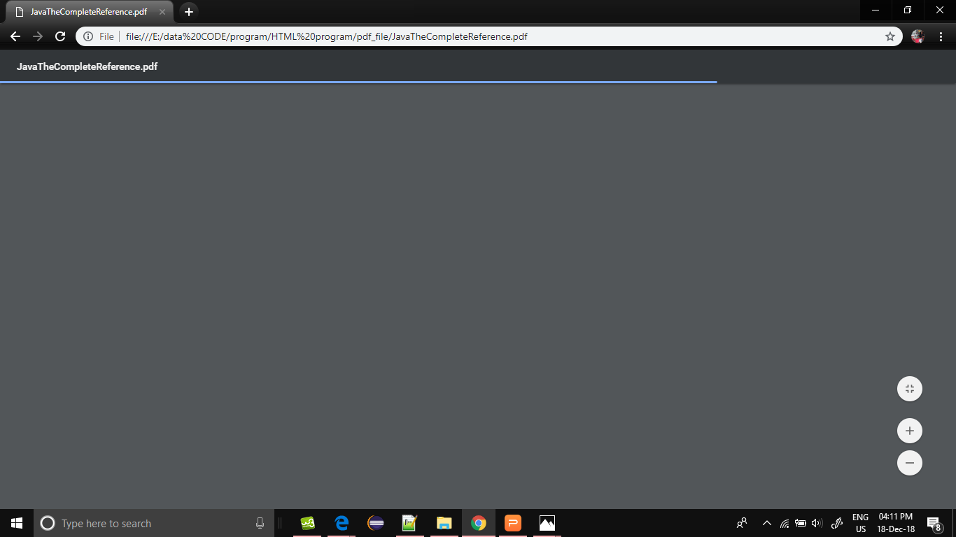
Open PDF and Download

Slide 13
Graph

Slide 14
.
.
Thank You

